Slide 1


IST 652 : Scripting for Data Analysis
FINAL PROJECT – Sports Analysis
Presented by :- Adarsh S, Nandita P
Prasun S, Tarun T

Slide 2
DATASETS DEFINITION
This dataset is about the Indian Premier League (IPL) cricket tournament until the year 2017. It contains detailed information
on each IPL match played until 2017, including the date and location of the match, the two teams that competed, the result,
and the scores. It also includes data on individual player performance, such as the number of runs scored, wickets taken,
and catches made. Additionally, the dataset includes information about the IPL teams, such as the team name, home ground,
and owner. This dataset can be used for various analytical purposes such as predicting match outcomes,
identifying player trends, and evaluating team performance.
For our analysis, we’ll be using 2 datasets.
Player by match : This dataset has around 13,993 data points across 22 columns. It contains details for each player by the match they played. It has columns like matchID, team1, team2, manOfTheMatch, PlayerName, PlayerID, DateOfBirth, etc.
Match : This dataset has 637 data points across 17 columns. It contains details of each match played from 2008 till 2017.
We will be merging these two datasets for our data exploration and analysis.
DATASETS LINKS
Main link : https://data.world/raghu543/ipl-data-till-2017 Match dataset link : https://data.world/raghu543/ipl-data-till-2017/workspace/file?filename=Match.csv Player by match link : https://data.world/raghu543/ipl-data-till-2017/workspace/file?filename=Player_match.csv

Slide 3
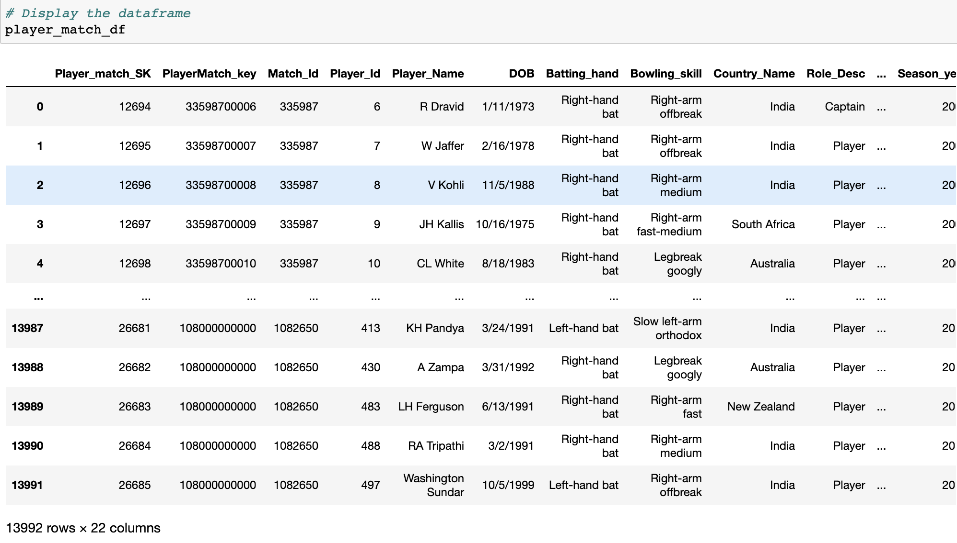
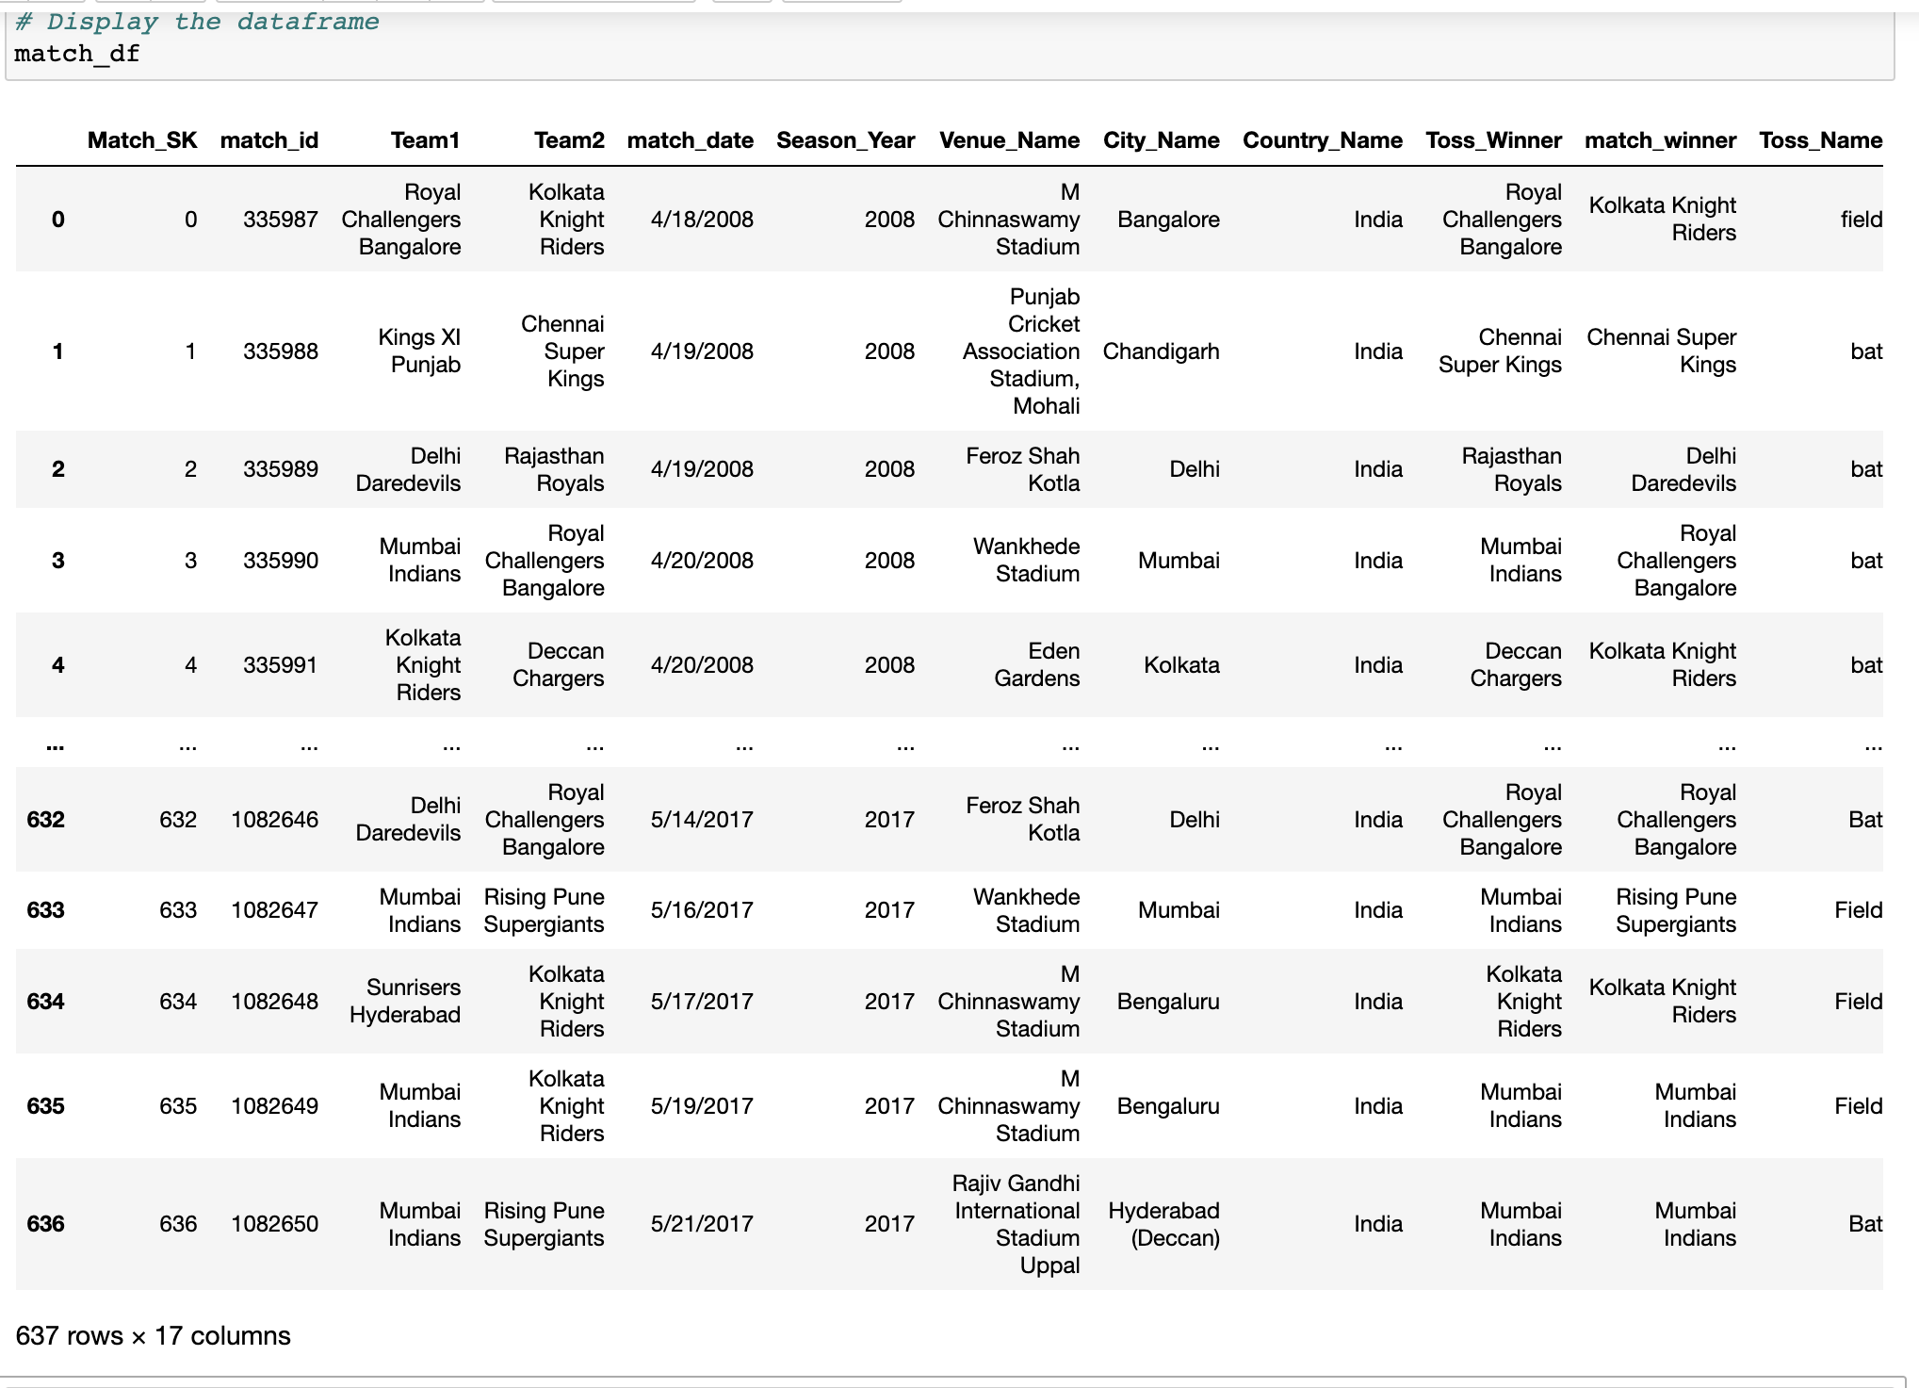
DATASETS
Player by match DATA
Match DATA

Slide 4
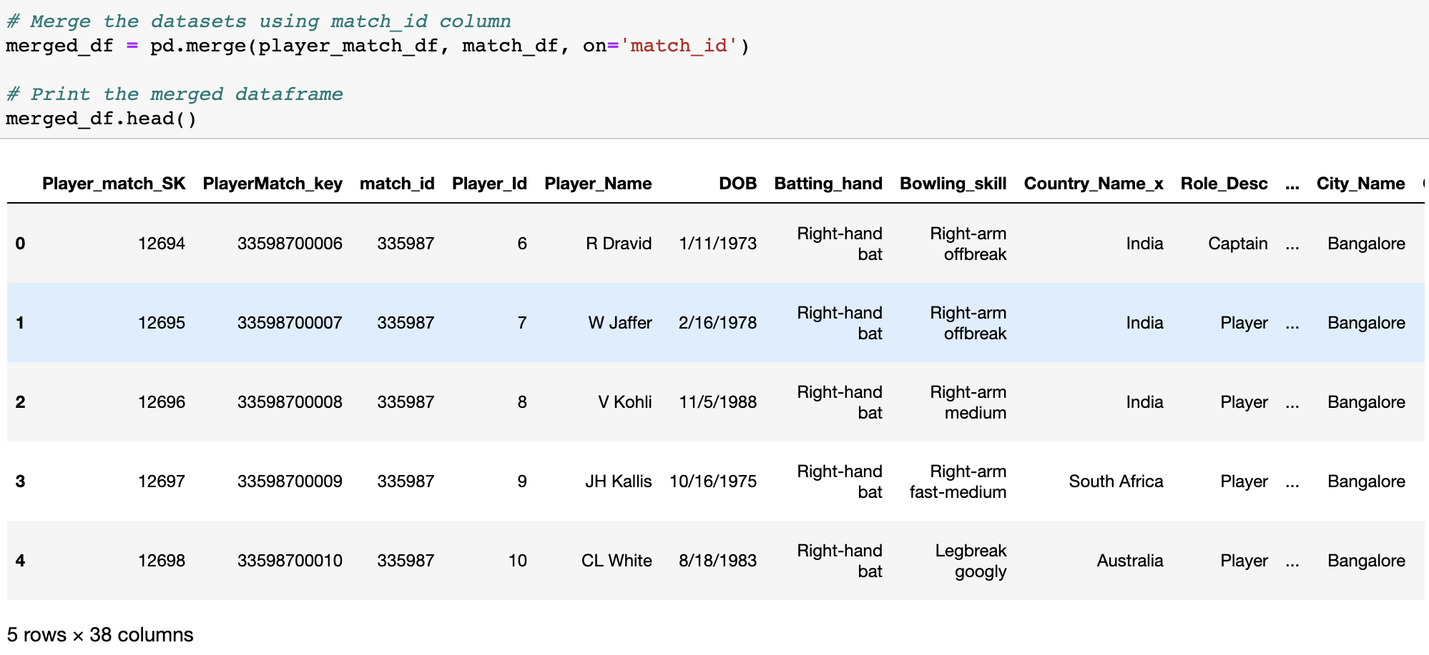
DATA CLEANING
Renaming the column to merge our datasets
based on the unique match_id for every data
point.
Merged dataset on the match_id column
This is the final dataset we have by merging our two main datasets. We have used this data for our analysis.

Slide 5
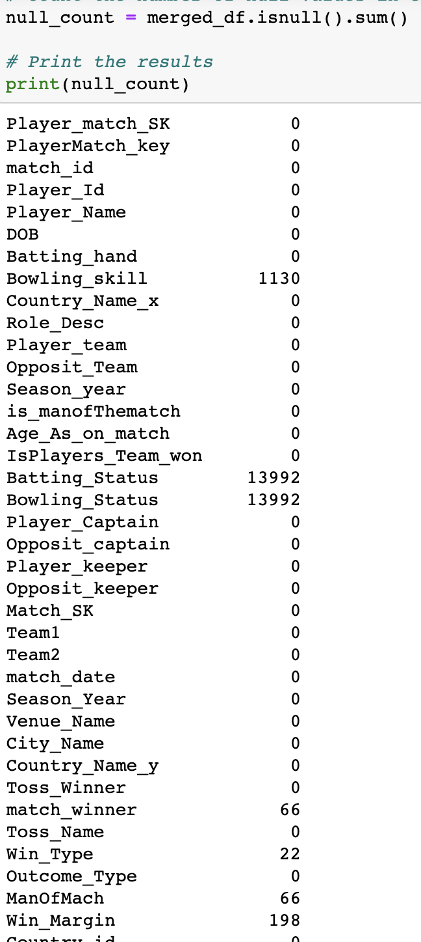
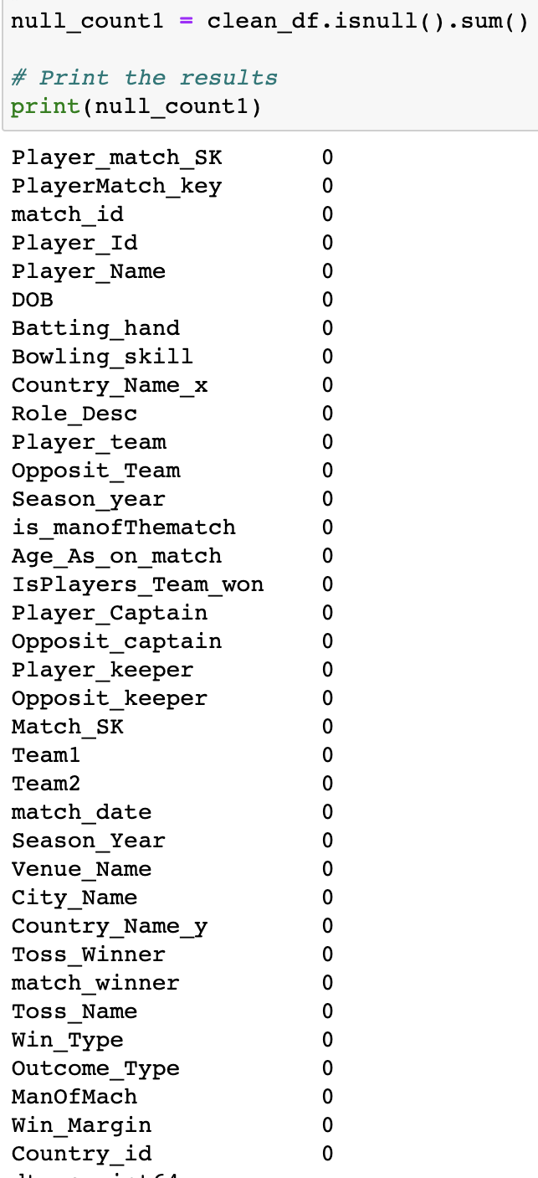
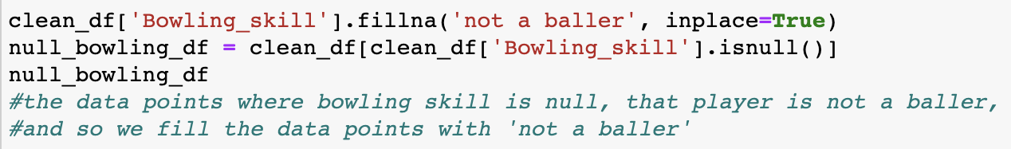
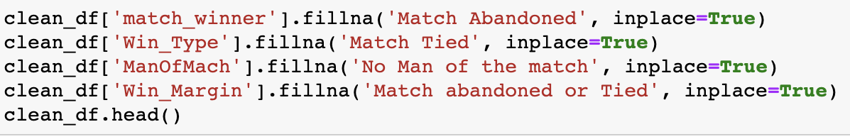
DATA CLEANING
Dropping insignificant columns
Changing values of NA fields for Bowling Skill column
Changing values for all the columns that are significant
and have NA values

Slide 6
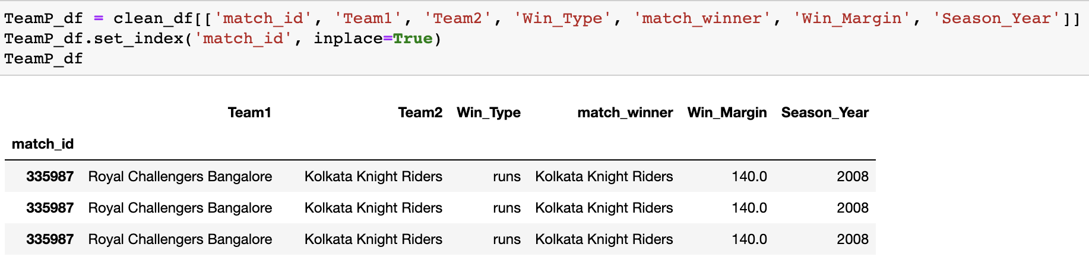
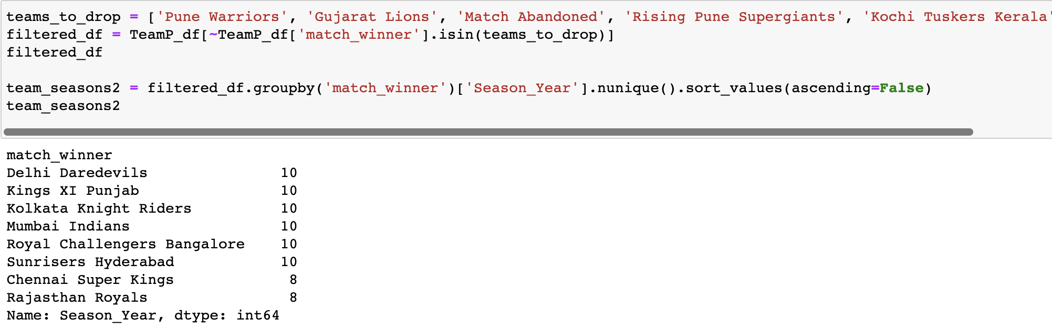
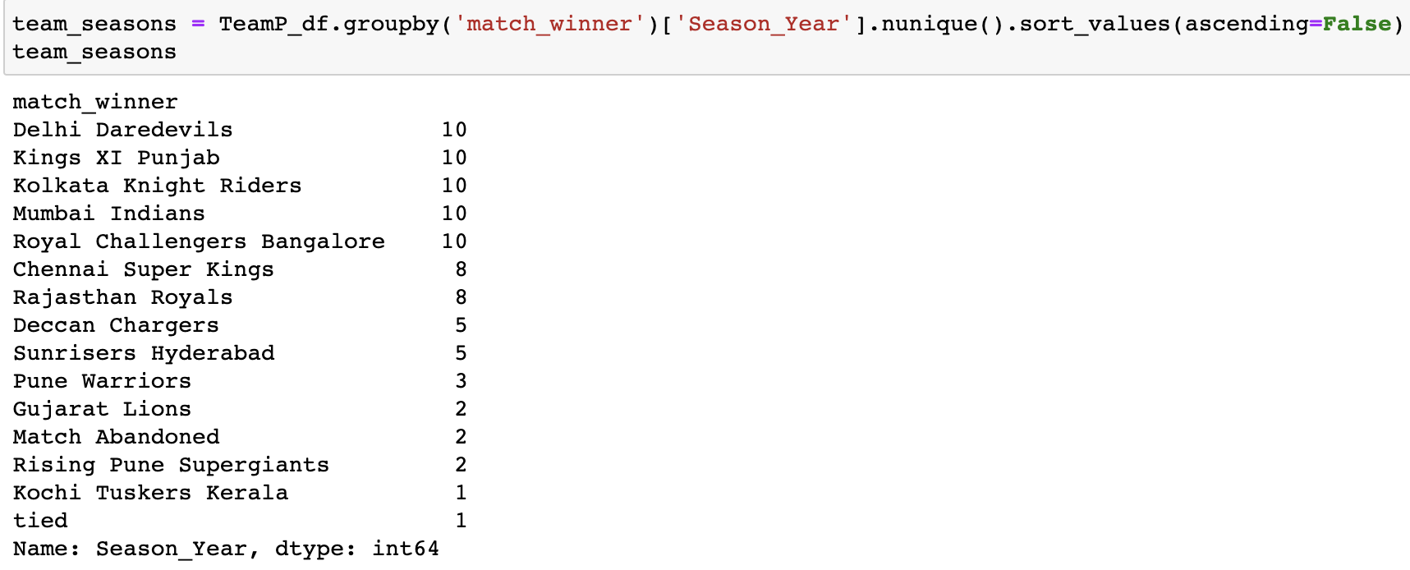
ANALYSIS and VISUALIZATION 1 : Team Performance Analysis
Question : How has the performances of different teams been over the years?
Sliced the dataset into a new dataframe to include only the columns that are significant to this analysis.
Number of seasons played by a team

Slide 7
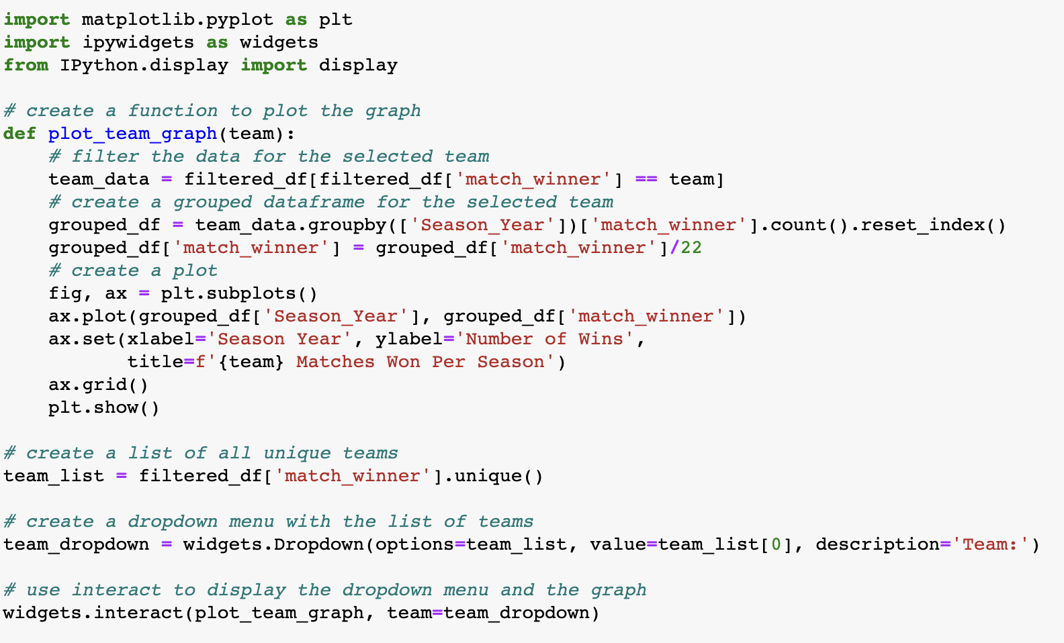
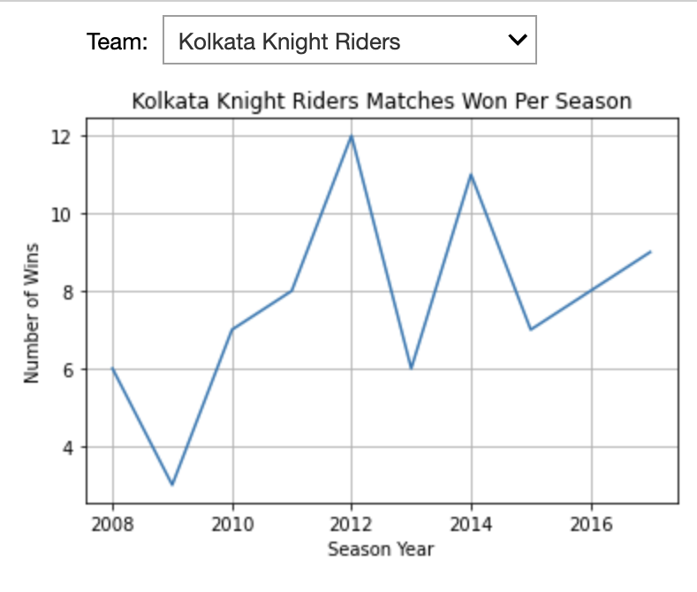
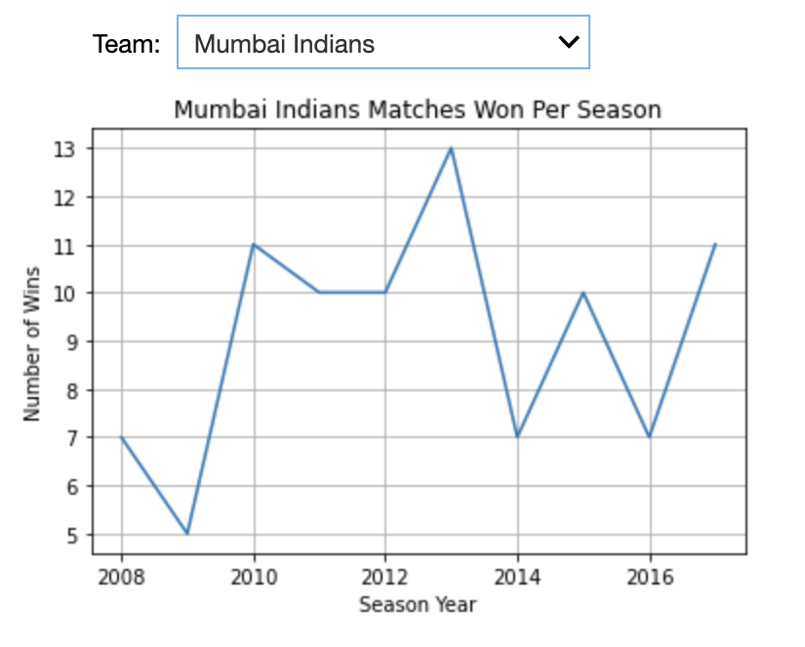
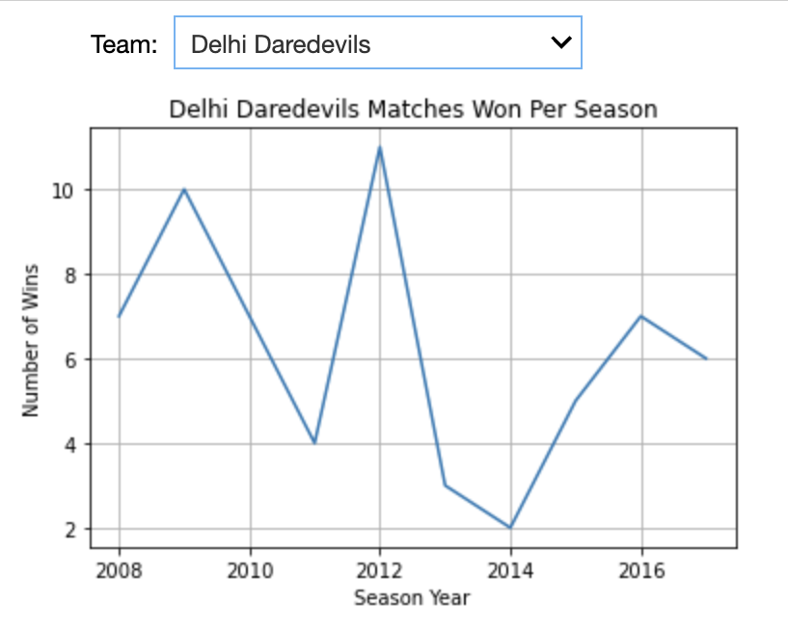
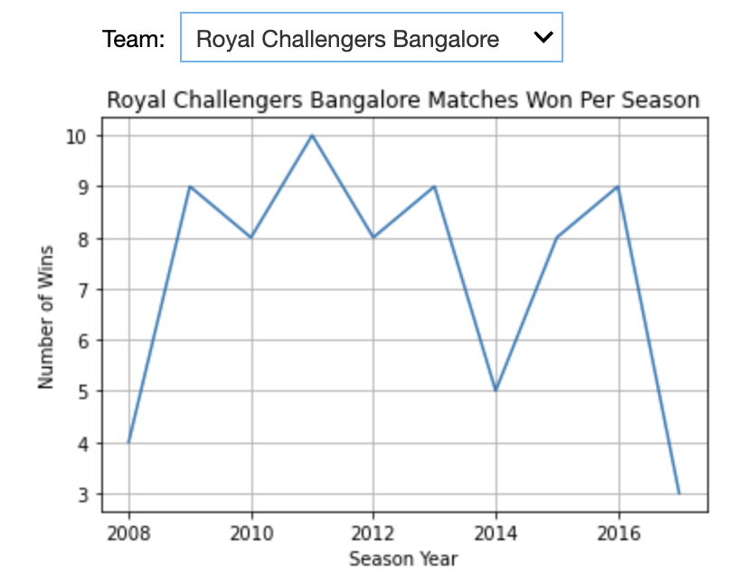
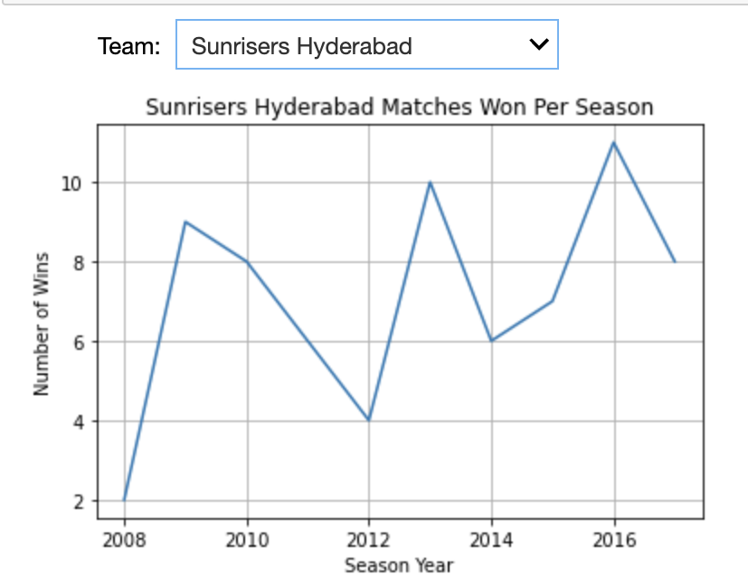
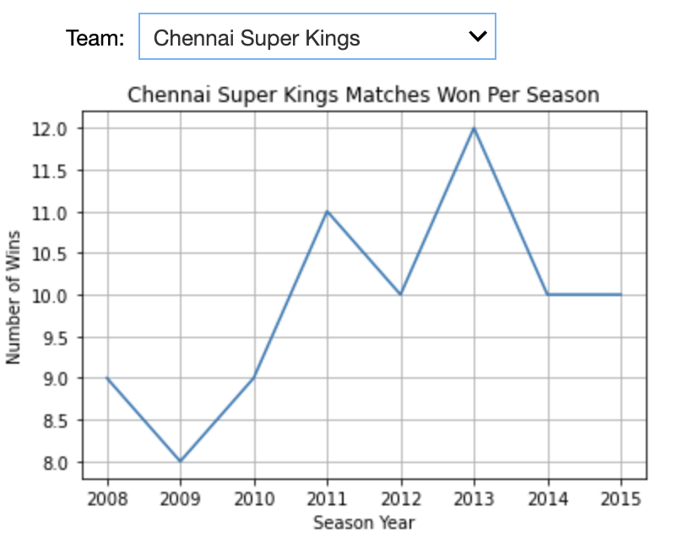
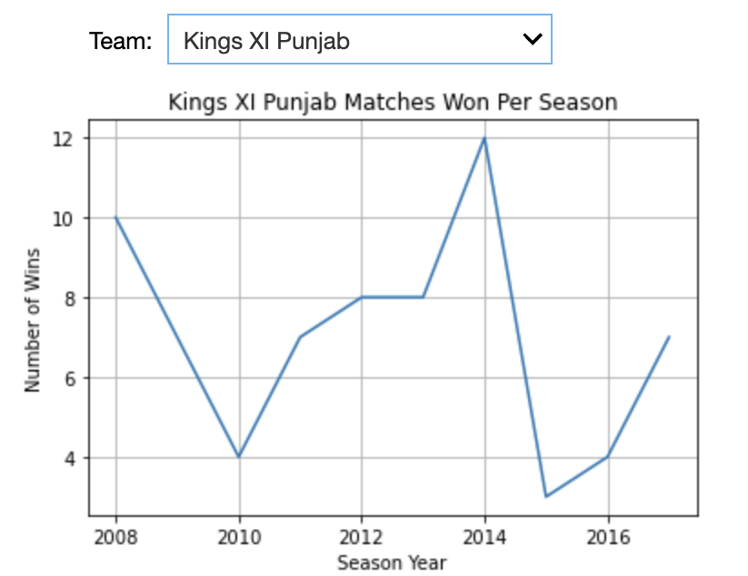
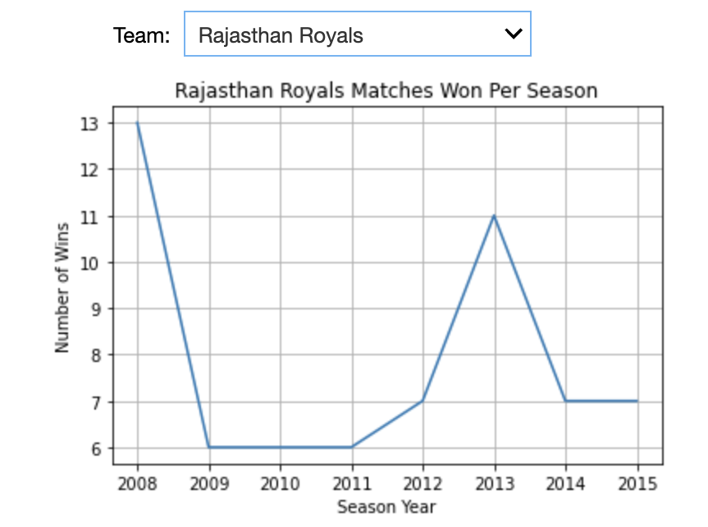

Slide 8
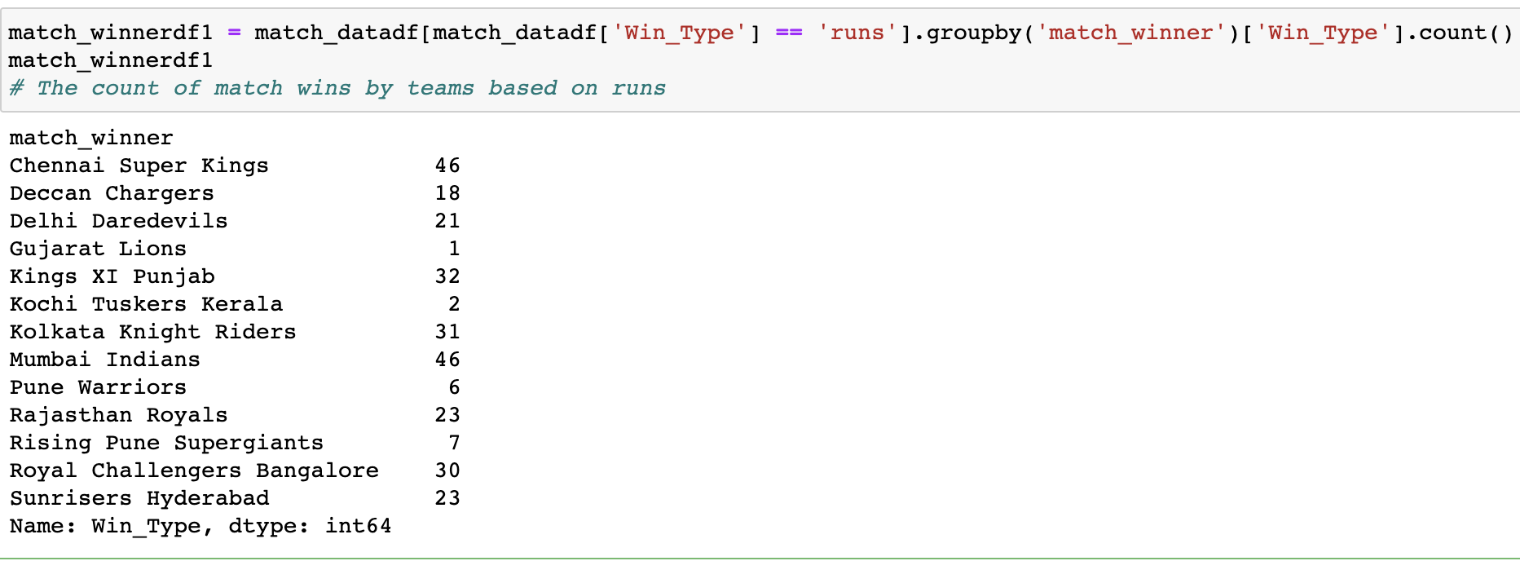
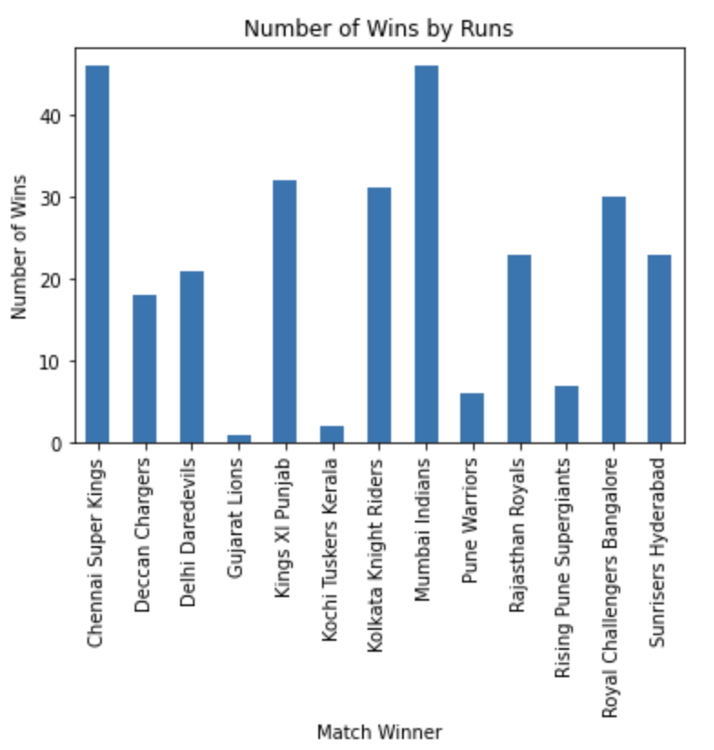
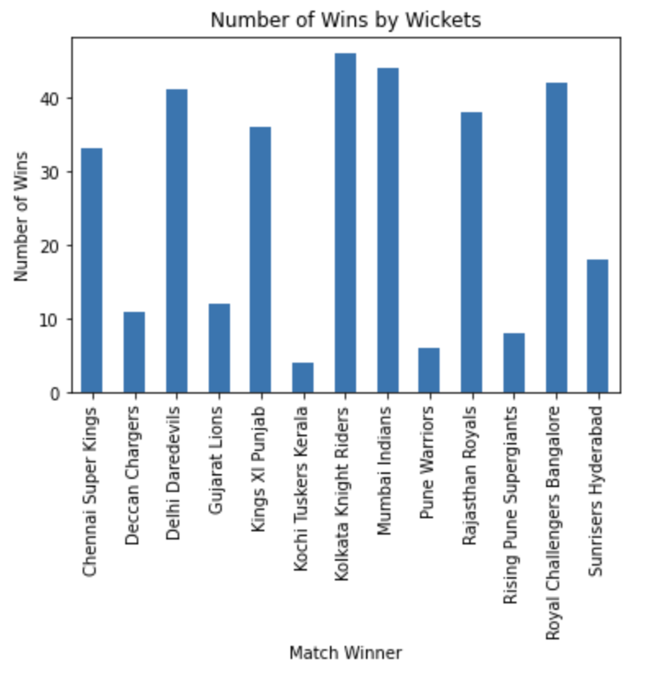
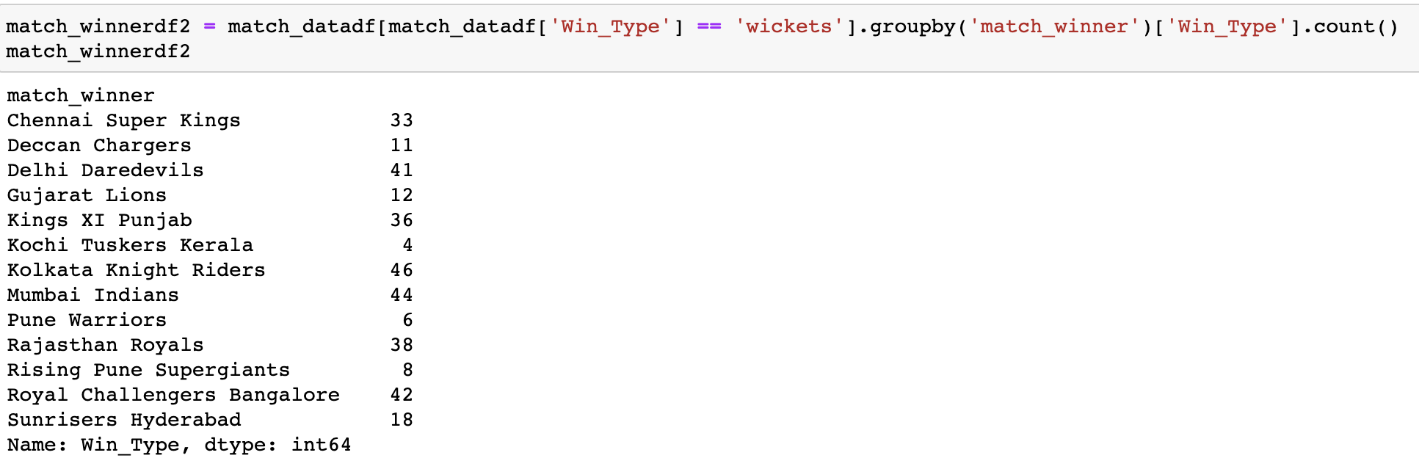
Matches won by teams : based on runs
Matches won by teams : based on wickets

Slide 9
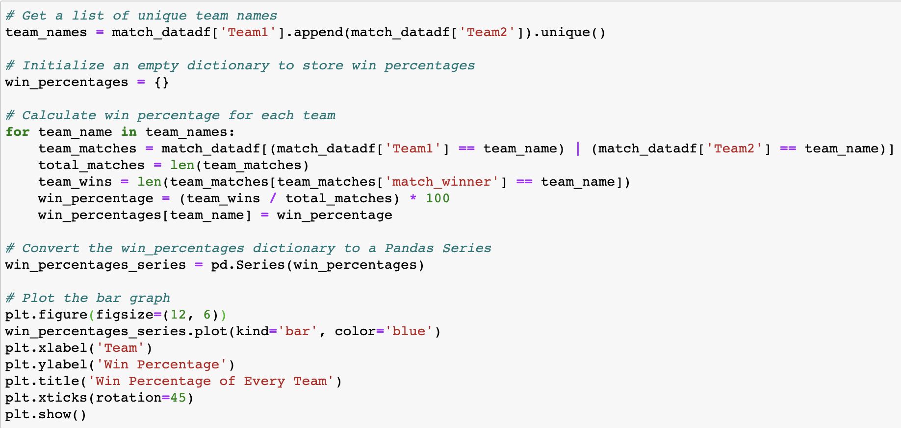
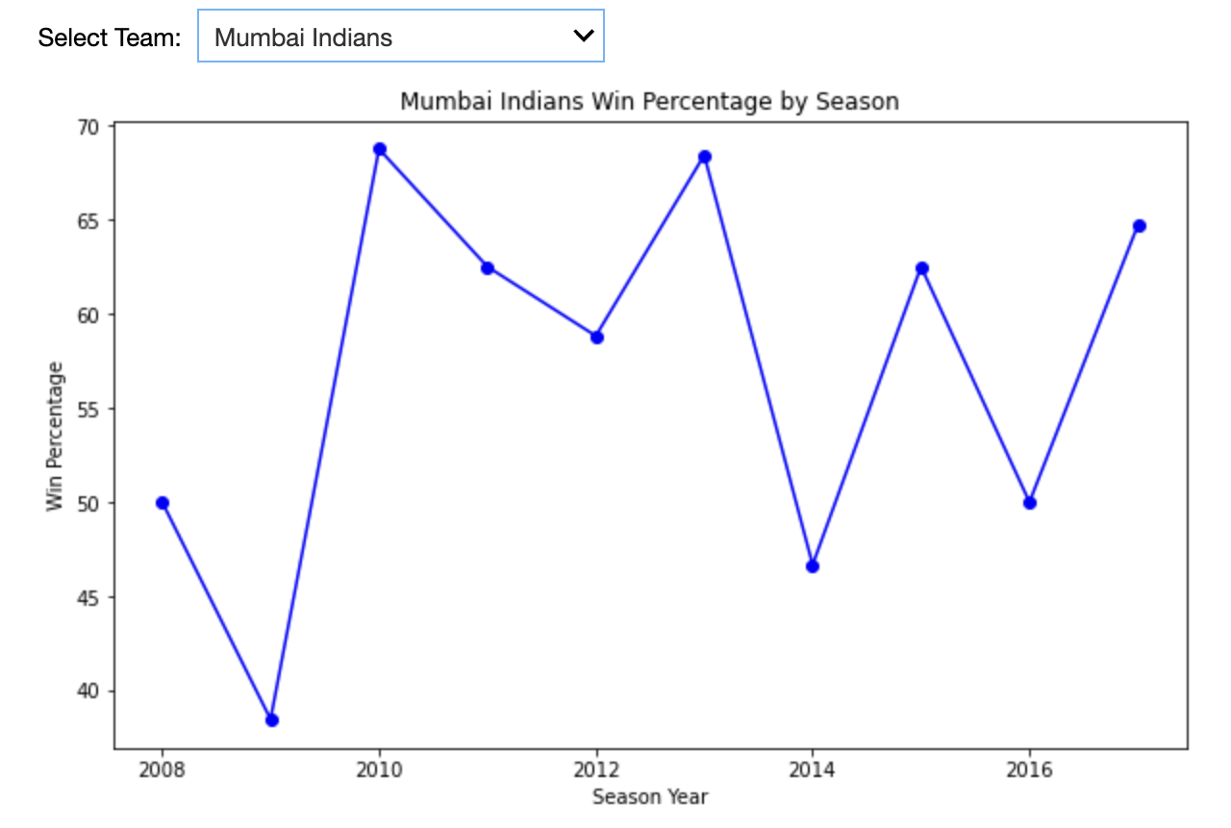
Conclusion : Analysis 1
Based on our analysis, it was observed that
Chennai Super Kings, Mumbai Indians, and
Sunrisers Hyderabad have the highest percentage
of wins, indicating that they win most of the matches
they play. Furthermore, these teams tend to win by a margin of runs, which suggests that their
batsmen are stronger and more successful.
By examining their performance graphs, it was found
that Sunrisers Hyderabad and Chennai Super Kings
have more linear graphs compared to other teams,
implying that they have a greater chance of winning
the 2018 season if we consider the trend.

Slide 10
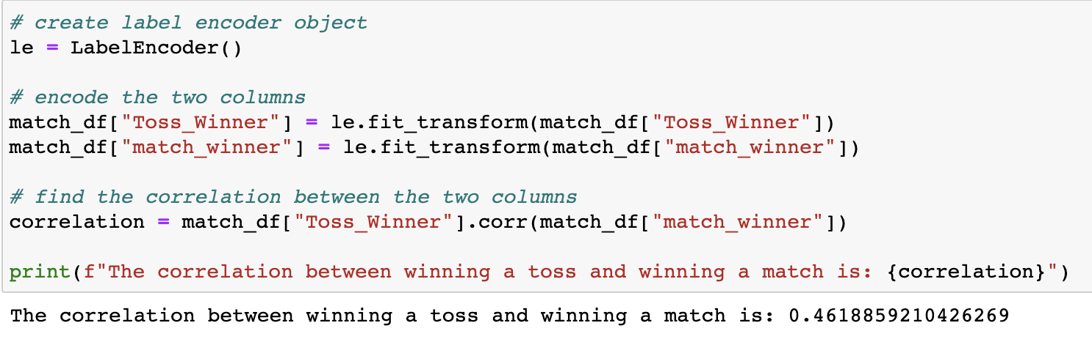
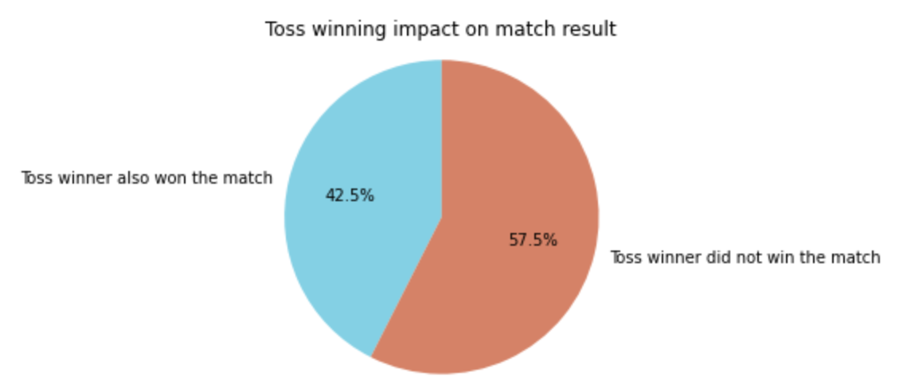
ANALYSIS and VISUALIZATION 2 : Toss Analysis
Question : Does winning or losing the toss affect if the team wins the match or not?
Conclusion : Analysis 2
According to our analysis,
it was observed that teams
that win the toss tend to
lose the match more often.
The implications of this
analysis suggest that winning
the toss does not necessarily
give a team an advantage in
winning the match. Other factors
such as team performance,
player skills, and game strategies
may have a greater impact on
the outcome of the match.

Slide 11
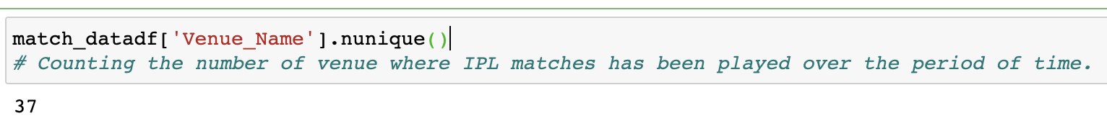
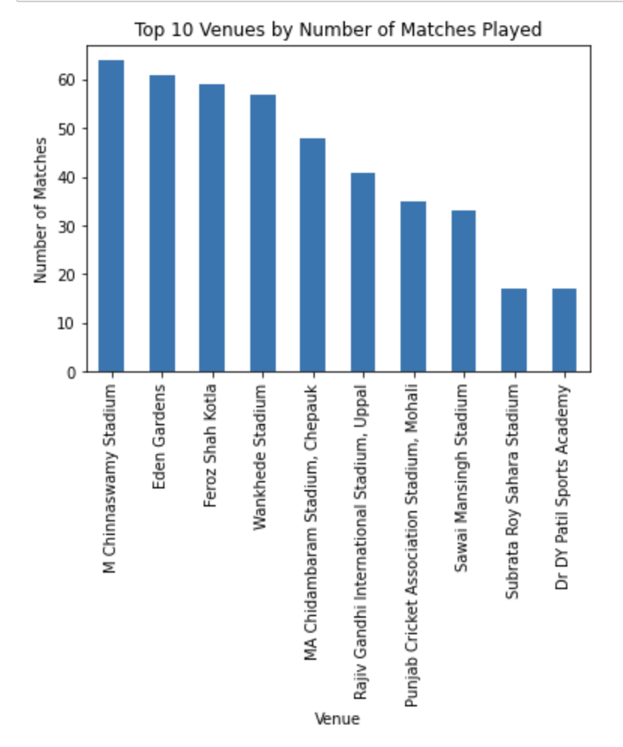
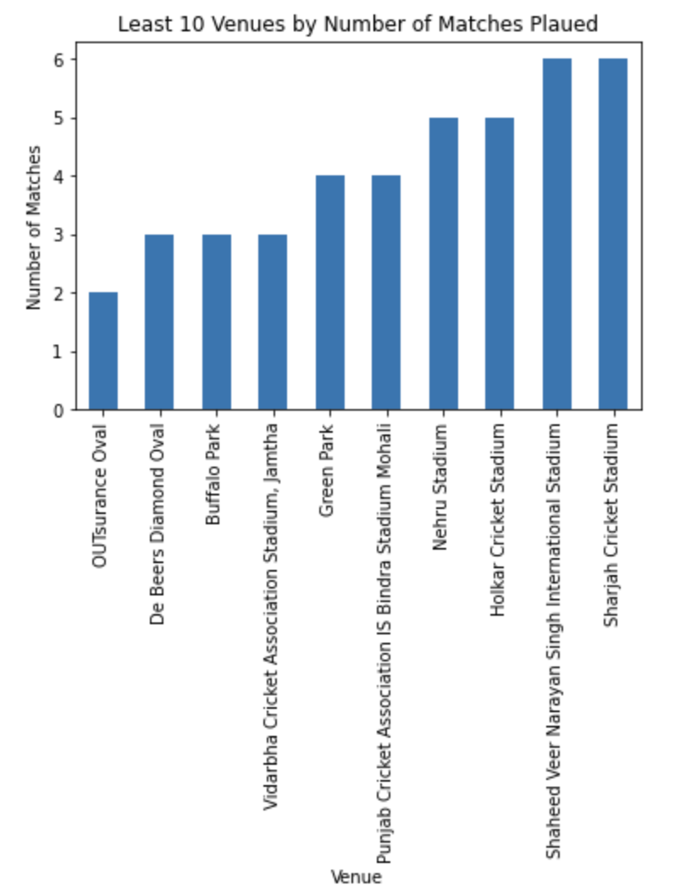
ANALYSIS and VISUALIZATION 3 : Venue Analysis
Question : Does venue and location of match affects whether a team wins the match or not?
37 unique venues
Most famous 5 venues : 1. M Chinnaswamy Stadium (64)
2. Eden Gardens (61) 3. Feroz Shah Kotla (59)
4. Wankhede Stadium (57)
5. MA Chidambaram Stadium (48)
Least famous 5 venues :
1. OUTsurance Oval (2)
2. De Beers Diamond Oval (3)
3. Buffalo Park (3)
4. Vidarbha Cricket Association
Stadium (3)
5. Green Park (4)

Slide 12
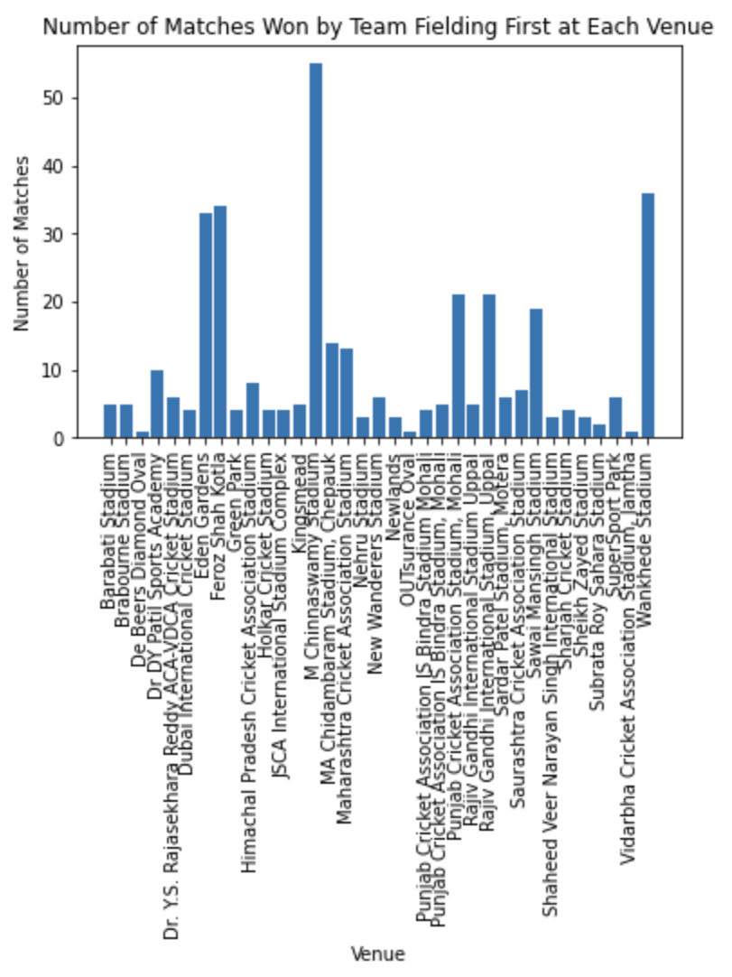
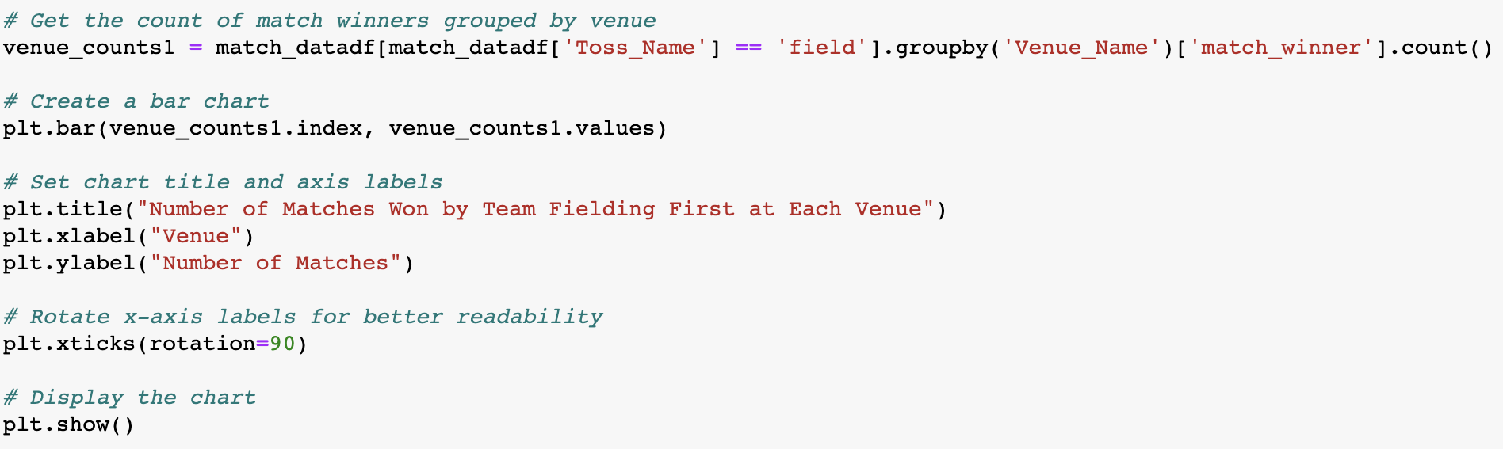
Conclusion : Analysis 3
According to the analysis, M Chinnaswamy Stadium
is the most favorable stadium for teams that opt to field
first after winning the toss. The implications of this
analysis suggest that teams can use this information to
make better decisions when playing at these stadiums.
If a team wins the toss at M Chinnaswamy Stadium, it may
be advantageous for them to field first to increase
their chances of winning.

Slide 13
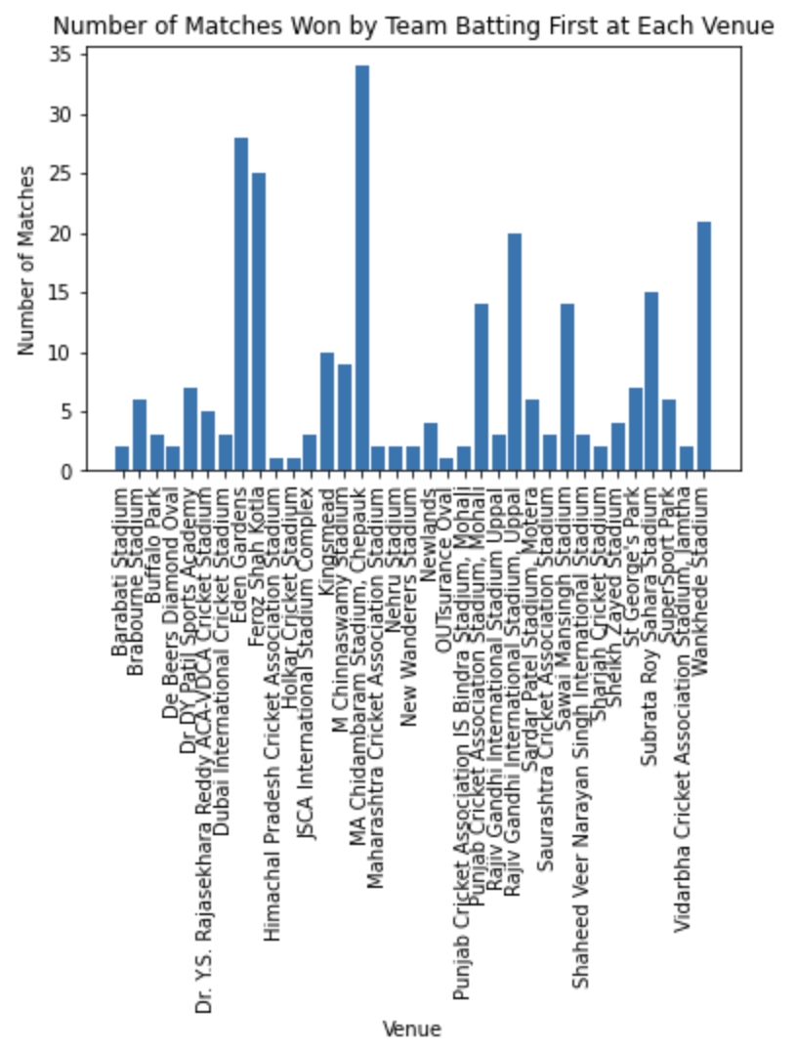
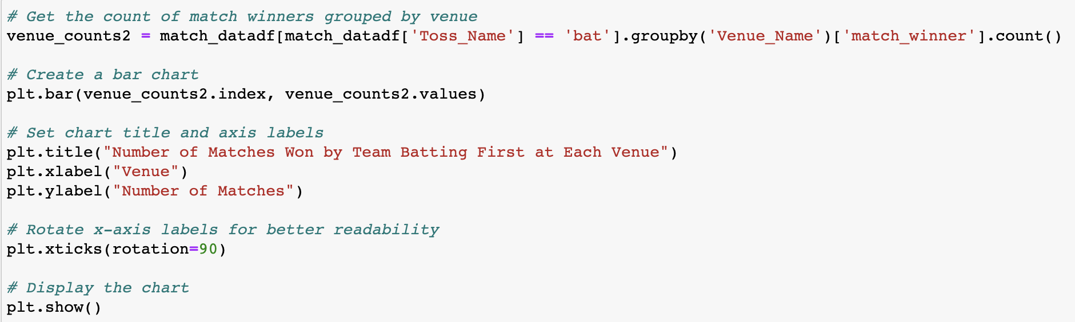
Based on the analysis, it can be concluded that MA
Chidambaram Stadium is not an ideal stadium for
teams that choose to field first due to their relatively
low winning statistics. However, the stadium is the best
option for teams that decide to bat first.
The implications of this analysis suggest that teams can
use this information to their advantage when playing at
MA Chidambaram Stadium. If a team wins the toss,
they may want to consider batting first to increase
their chances of winning. This can provide teams with
a strategic edge over their opponents and enhance their
overall performance at the stadium.

Slide 14
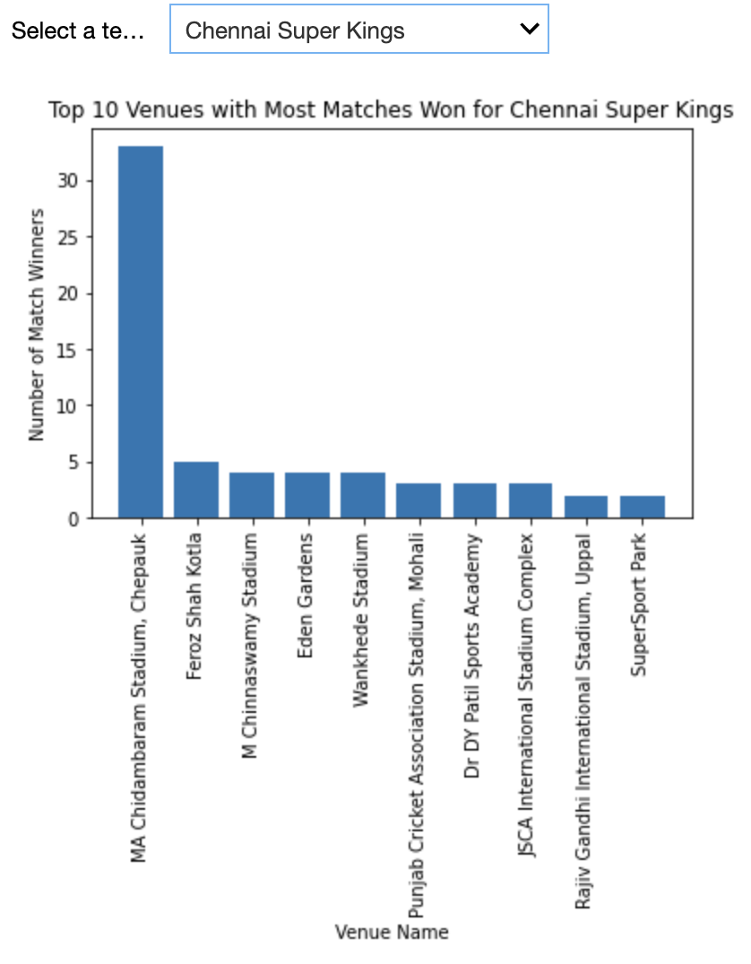
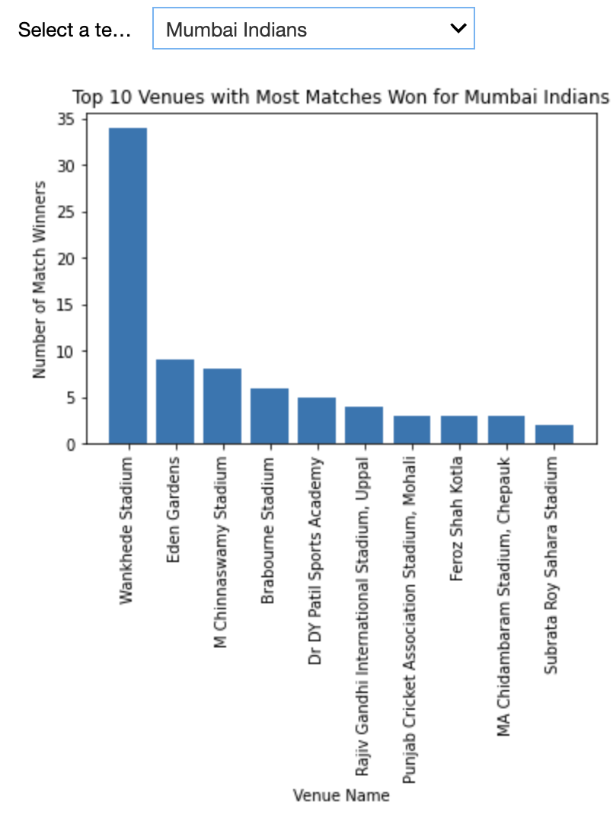
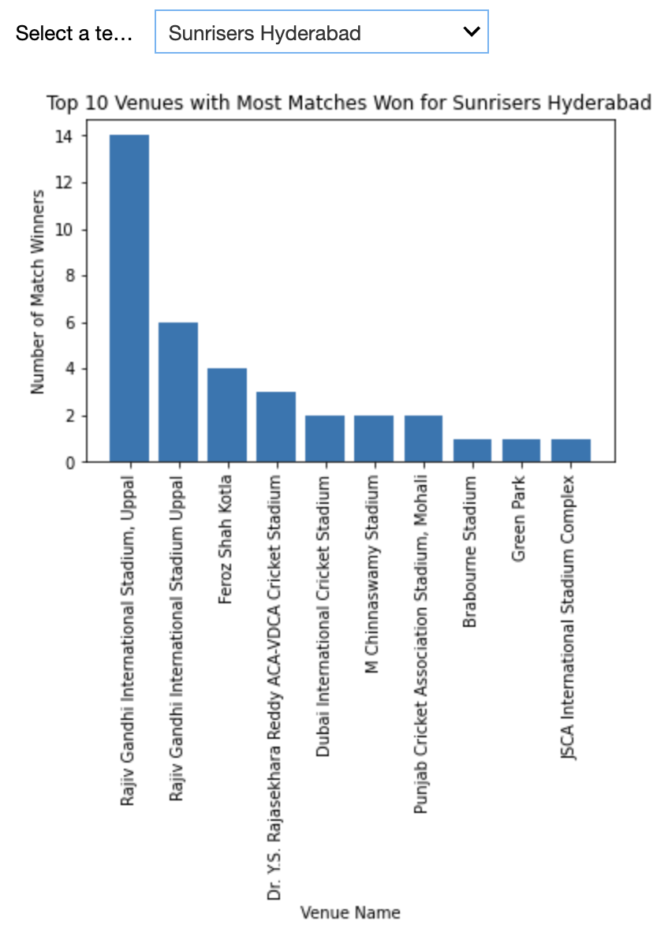
This analysis can help us understand the strengths and weaknesses of each team in different playing conditions.
Secondly, analyzing the top 10 venues can help teams develop effective match strategies. Teams can use this information to
identify the most favorable venues for them and tailor their playing style accordingly. For example, if a team has a high win
percentage at a particular venue, they may want to focus on their strengths and play aggressively to increase their chances
of winning. Overall, analyzing the top 10 venues for each team where they have won matches can provide valuable insights
into team performance, playing conditions, and match strategies

Slide 15
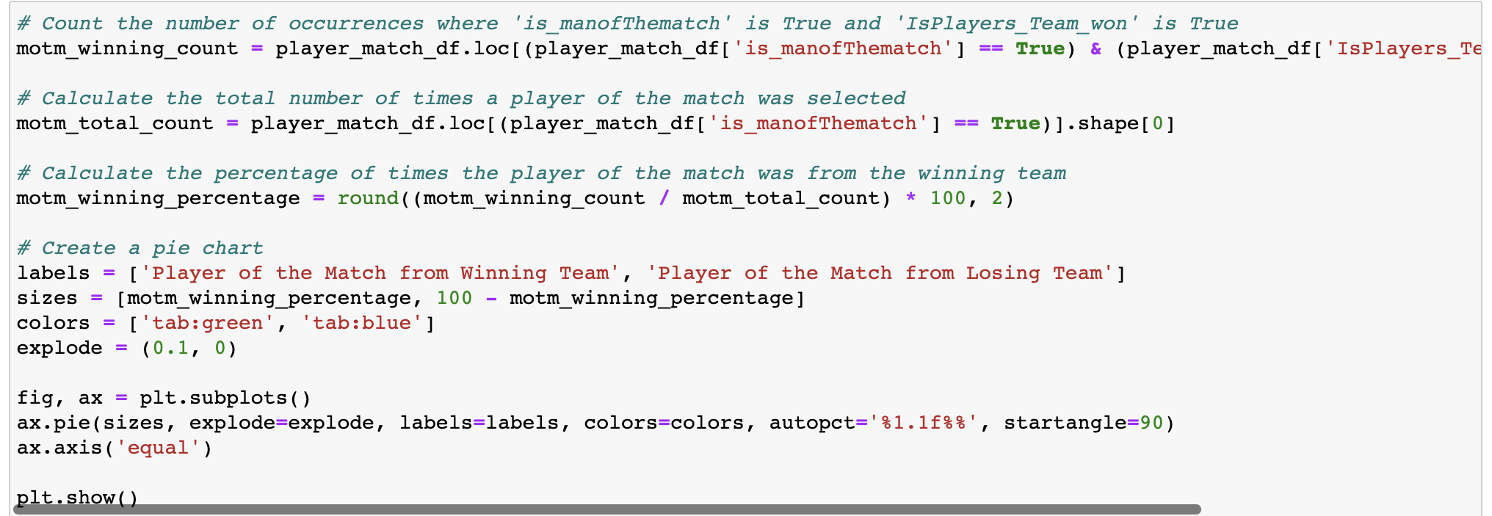
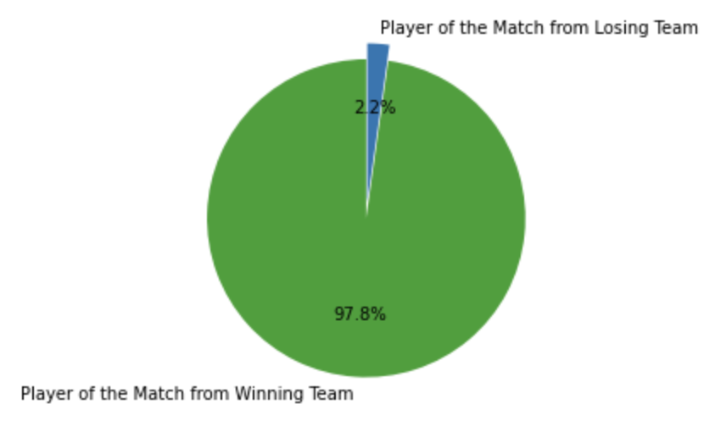
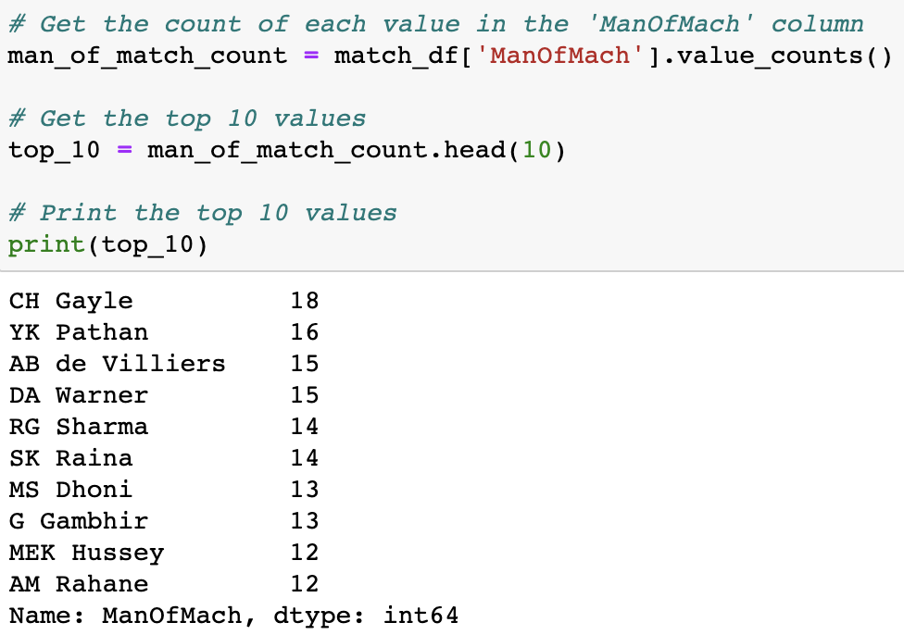
ANALYSIS and VISUALIZATION 4 : Player Performance Analysis
Question : Which player has what kind of performance, whether the player was man of the match, if yes, for how many matches, also based on whether they are the captain or not?
According to the analysis, it is evident that the man of the match award is
most often given to a player from the winning team. The implications of
this analysis suggest that individual player performance is closely linked
to team success. Players who perform exceptionally well and contribute
significantly to their team's victory are more likely to receive recognition
in the form of the man of the match award. This highlights the importance
of teamwork and collective effort in achieving success in cricket. Additionally,
teams may want to focus on developing players who can make a significant
impact on the game and increase their chances of winning matches.

Slide 16
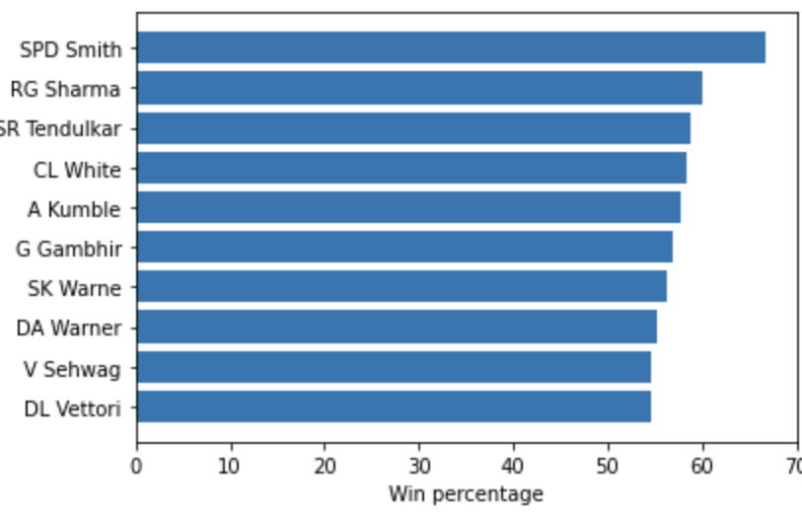
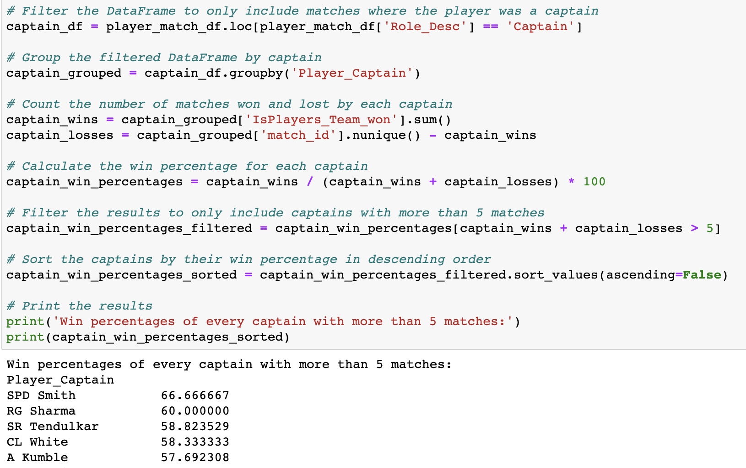
Winning percentage of captains who have played more than 5 matches as captains.
The analysis can help us identify the effectiveness of different
captains and their leadership styles. Captains who have a higher win
percentage may have leadership qualities that positively impact the
team's performance, such as effective communication, strategic
decision-making, and motivation.
Conclusion : Analysis 4
The analysis can also provide insights into the
overall team dynamics and how different captains
interact with their teammates. Captains who are
able to build strong relationships with their team
members and foster a positive team culture may
be more successful in achieving team goals.

Slide 17
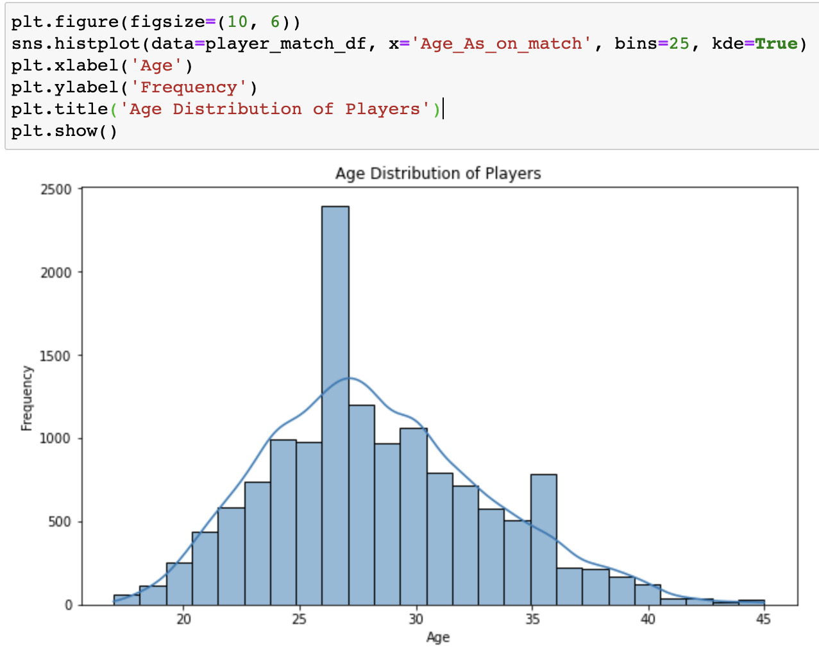
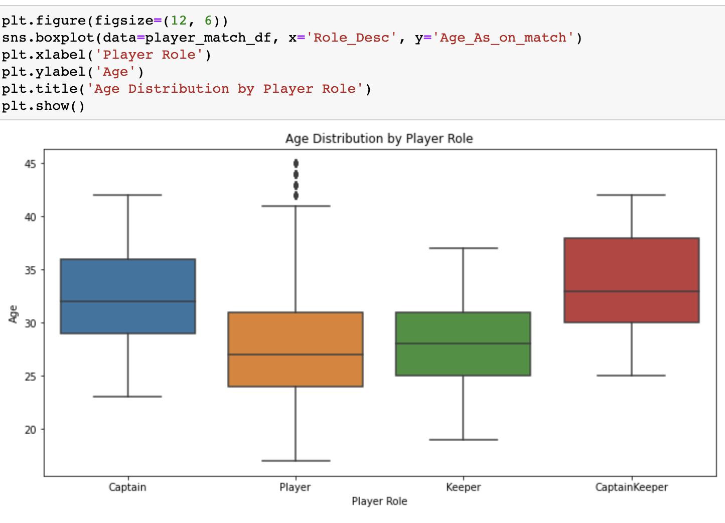
Age distribution of IPL players
The age distribution can provide insights into the overall experience level of the team. A team with a higher number of
older, more experienced players may have an advantage over a team with a younger, less experienced lineup. This experience
can translate into better decision-making, better game management, and better leadership. We observe that captains are more
than other players, indicating that captains are usually more experienced than others. Meanwhile, players who are not captains
come from a younger age group, which means that the team management may be focusing on building a team for the future by
recruiting and developing younger players who have the potential to become future leaders.

Slide 18
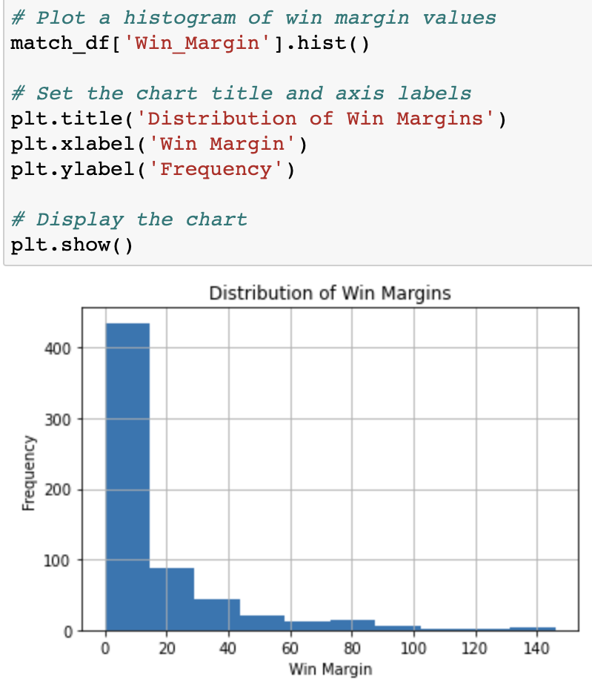
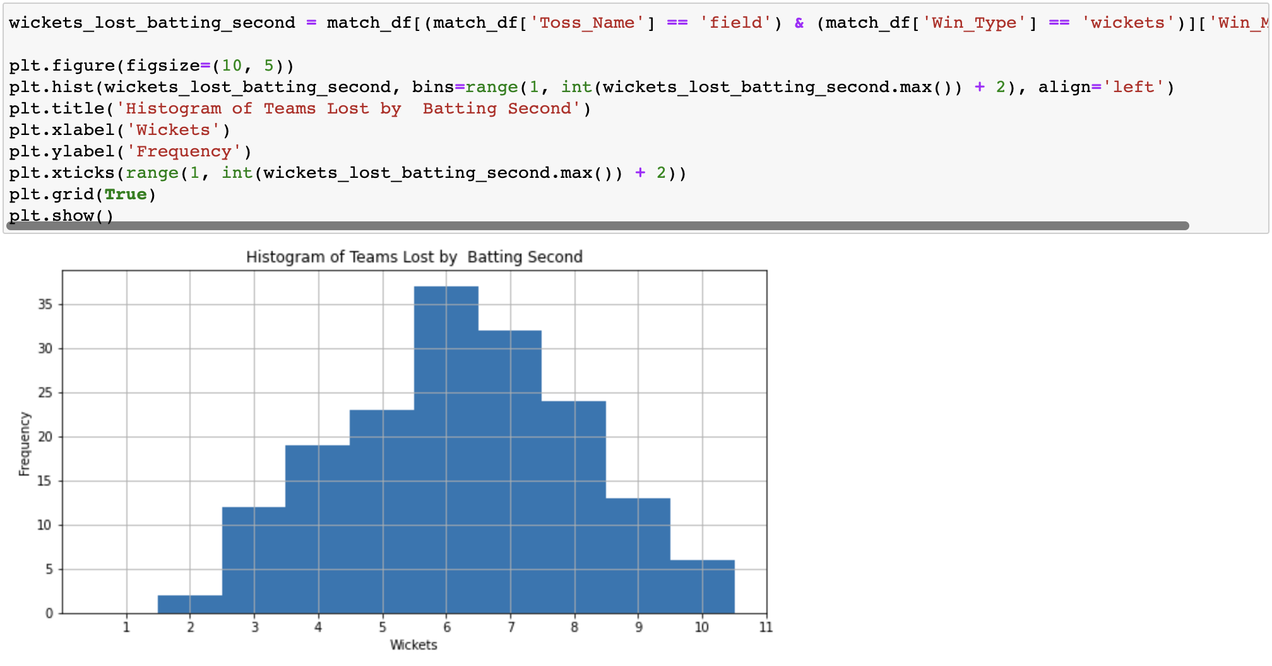
ANALYSIS and VISUALIZATION 5 : Win Margin Analysis
Question : Which factor contributes more to the teams that win matches – runs or wickets?
Conclusion : Analysis 5
Analyzing the margin of victory can also provide insights into a team's ability to handle pressure and perform under different
circumstances. For example, if a team is consistently winning by a large margin of runs, it may suggest that they are able to
perform well under pressure and maintain their dominance throughout the match. On the other hand, if a team is consistently
winning by a narrow margin of wickets, it may suggest that they are able to handle pressure situations well and are capable of
winning close matches.

Slide 19
QUESTIONS?

Slide 20


